Slide 1



Animal Pictures for Past Tense Elicitation
Index of characters by slide number:
2. Bear
3. Cat
4. Caterpillar
5. Cow
6. Crocodile
7. Dog
8. Dolphin
9. Dragon
10. Duck
11. Fish
12. Fox
13. Frog
14. Giraffe
15. Goat
16. Horse
17. Ladybird
18. Lion
19. Monkey
20. Monster
21. Mouse
22. Octopus
23. Panda
24. Parrot
25. Penguin
26. Pig
27. Rabbit
28. Seal
29. Sheep
30. Snail
31. Spider
32. Tiger
33. zebra
Made available by Dr. Anna Theakston & Dr. Anna Woollams, University of Manchester
ESRC Grant no. ES/I021612/1

Slide 2

Notes:
BEAR

Slide 3
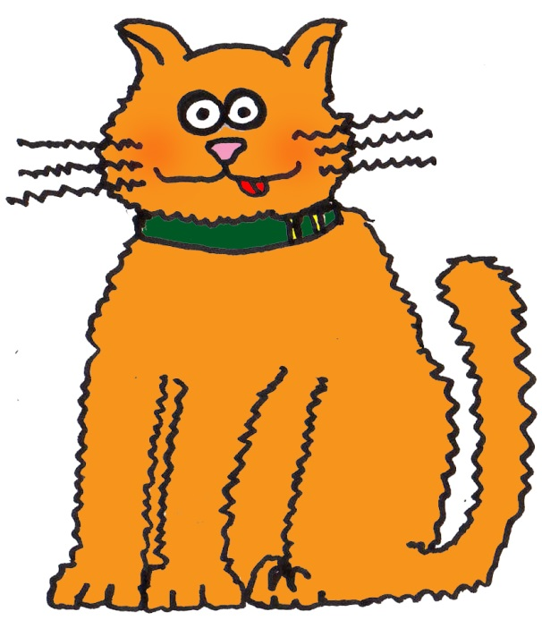
Notes:
CAT

Slide 4
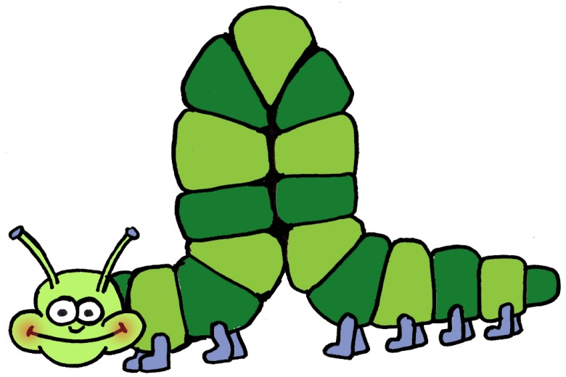
Notes:
CATERPILLAR

Slide 5
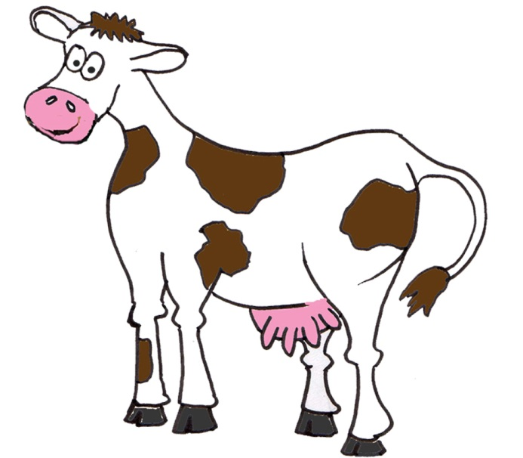
Notes:
COW

Slide 6
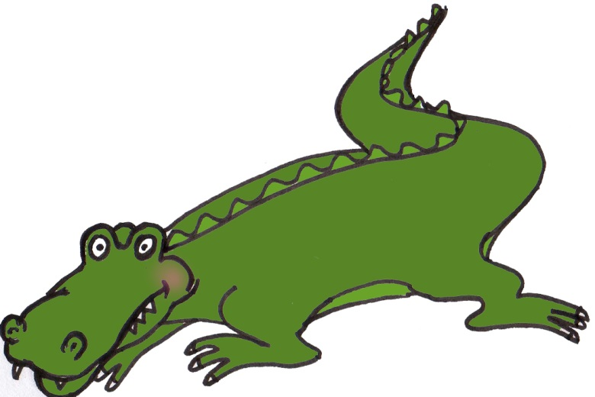
Notes:
CROCODILE

Slide 7
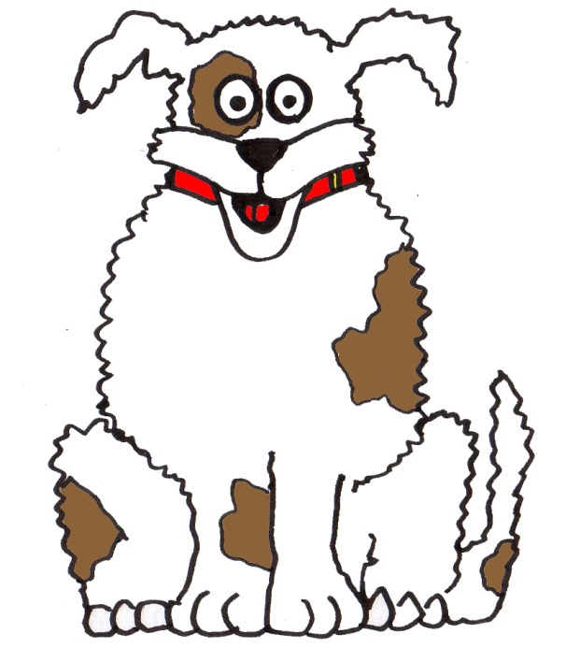
Notes:
DOG

Slide 8
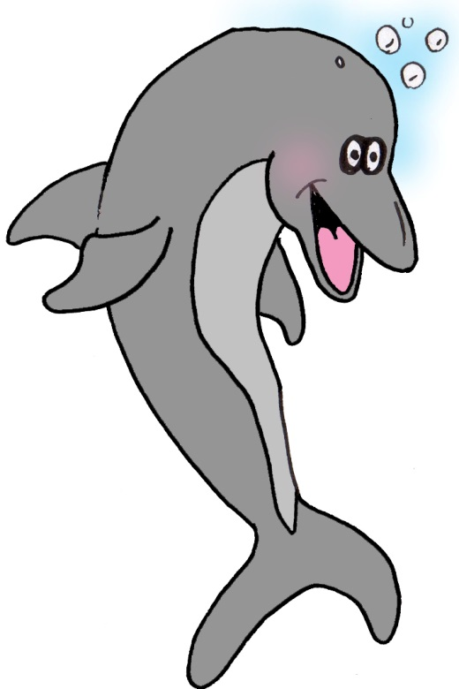
Notes:
DOLPHIN

Slide 9
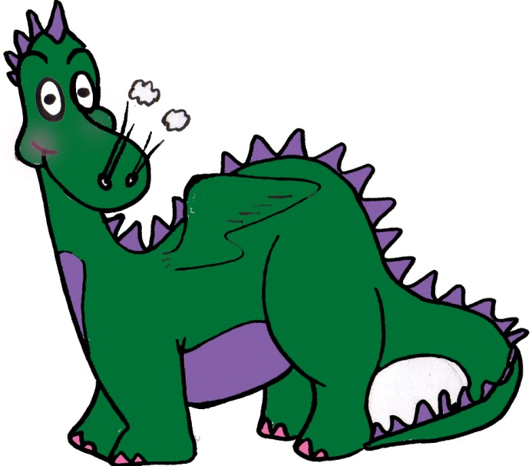
Notes:
DRAGON

Slide 10
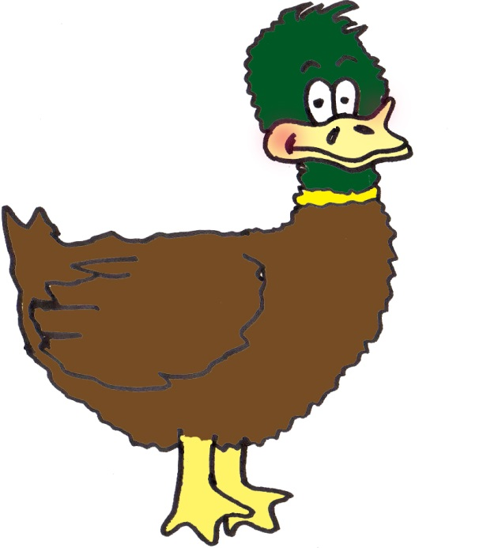
Notes:
DUCK

Slide 11

Notes:
FISH

Slide 12
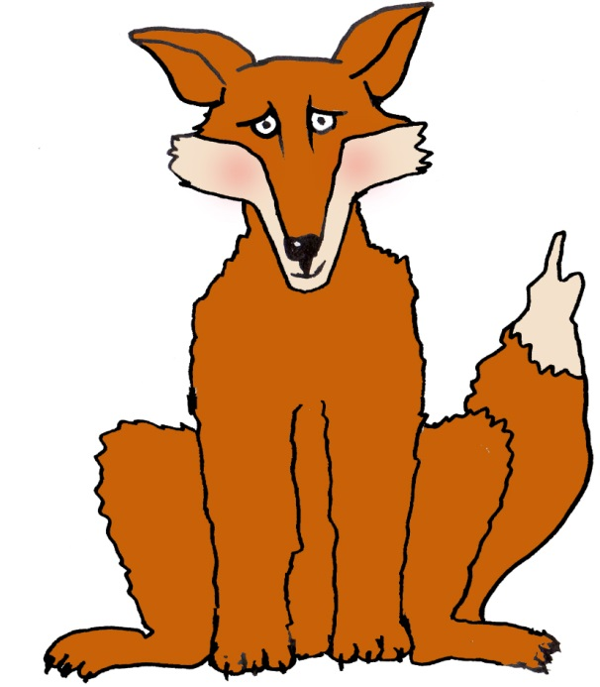
Notes:
FOX

Slide 13
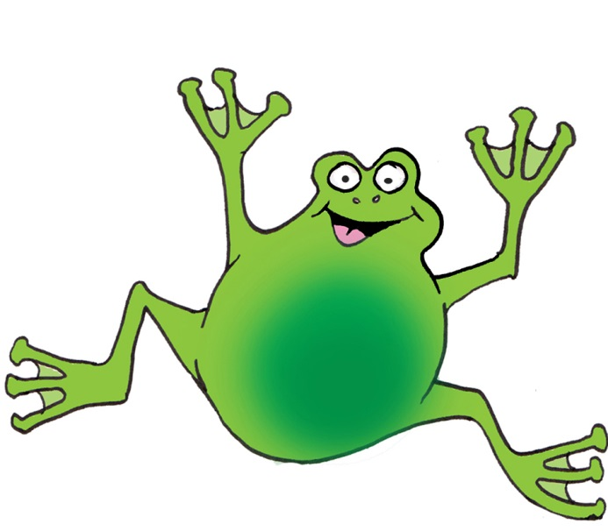
Notes:
FROG

Slide 14
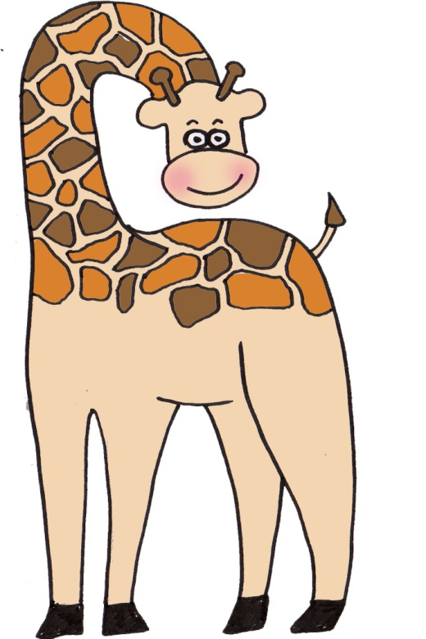
Notes:
GIRAFFE

Slide 15
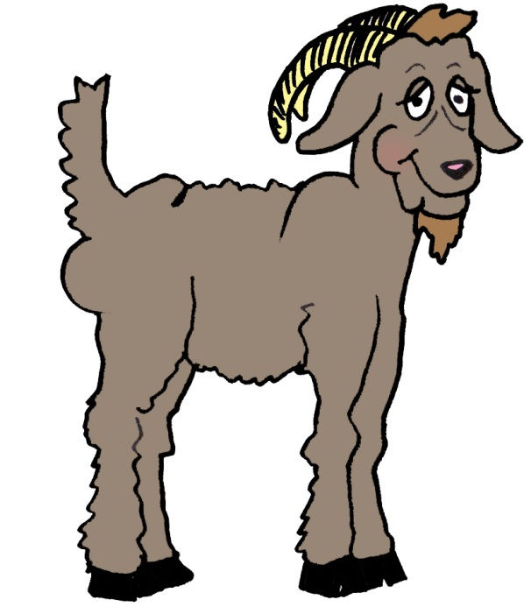
Notes:
GOAT

Slide 16
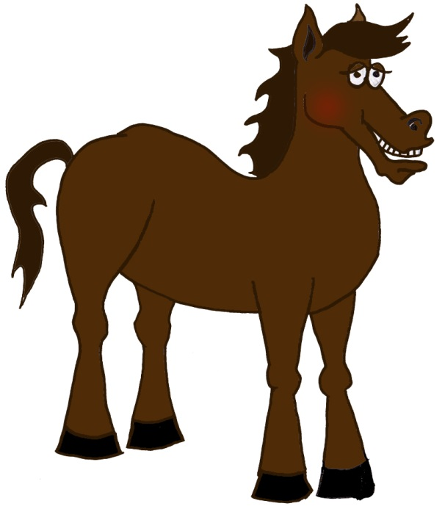
Notes:
HORSE

Slide 17
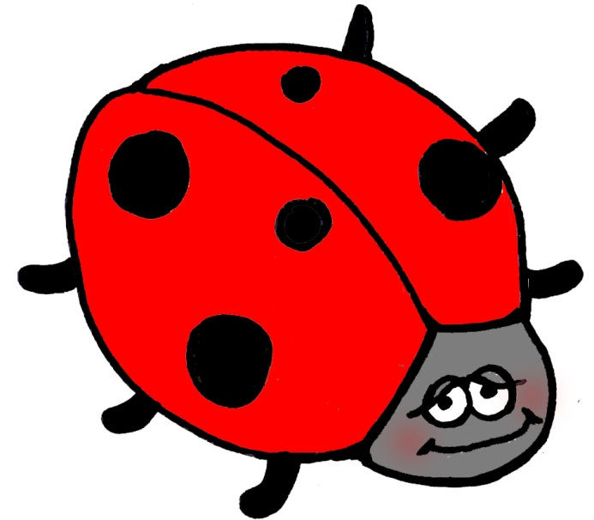
Notes:
LADYBIRD

Slide 18
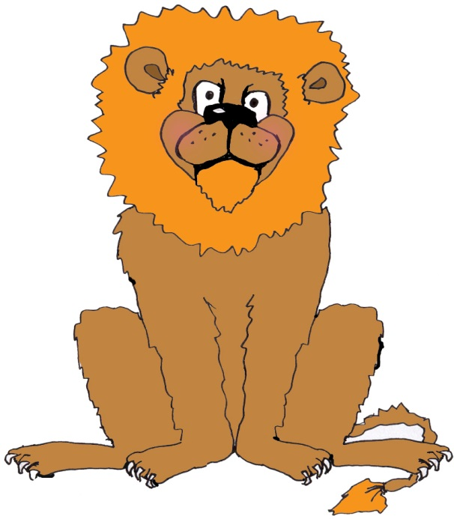
Notes:
LION

Slide 19
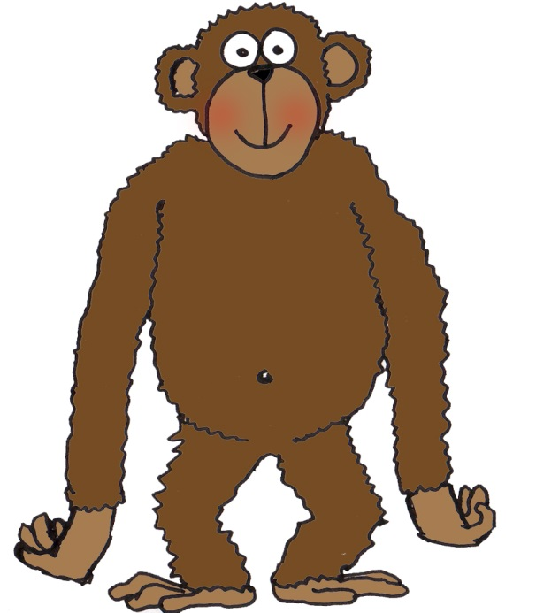
Notes:
MONKEY

Slide 20
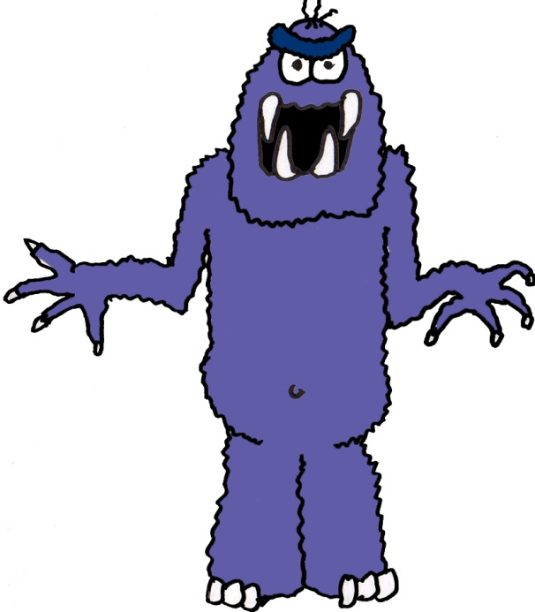
Notes:
MONSTER

Slide 21
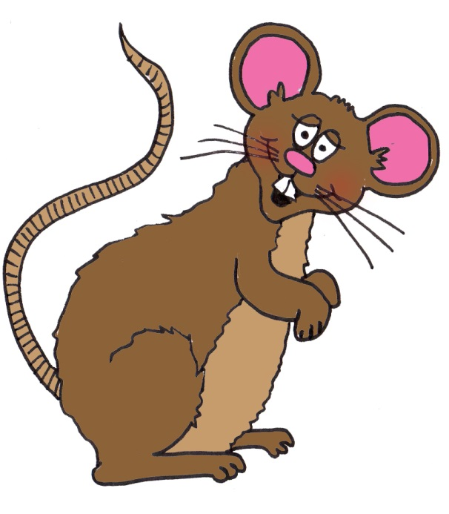
Notes:
MOUSE

Slide 22

Notes:
OCTOPUS

Slide 23
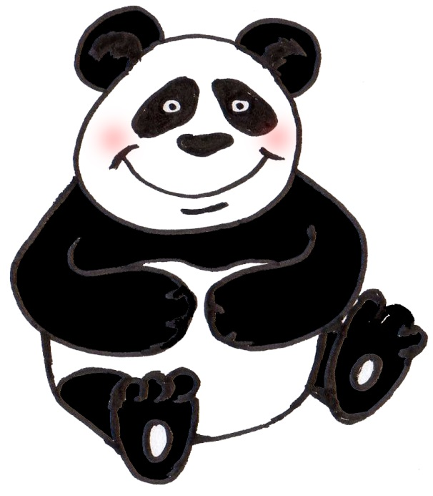
Notes:
PANDA

Slide 24
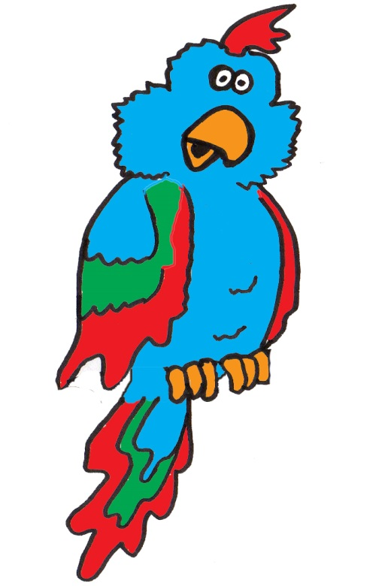
Notes:
PARROT

Slide 25
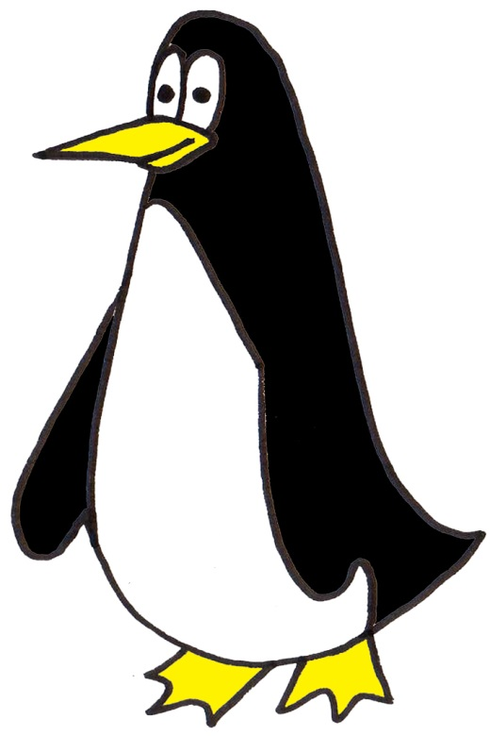
Notes:
PENGUIN

Slide 26
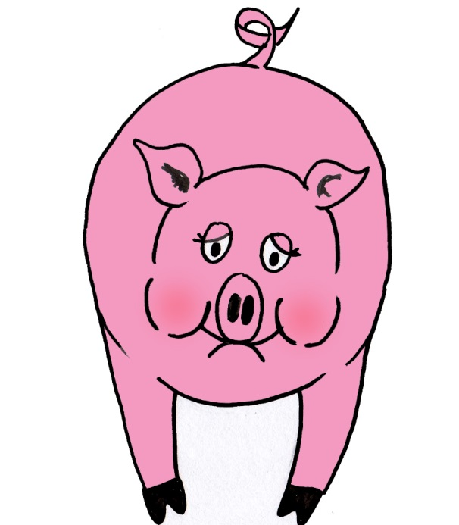
Notes:
PIG

Slide 27
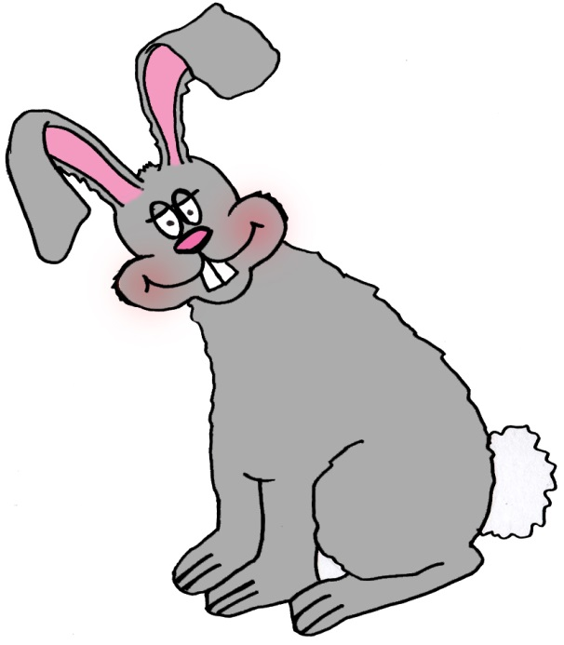
Notes:
RABBIT

Slide 28
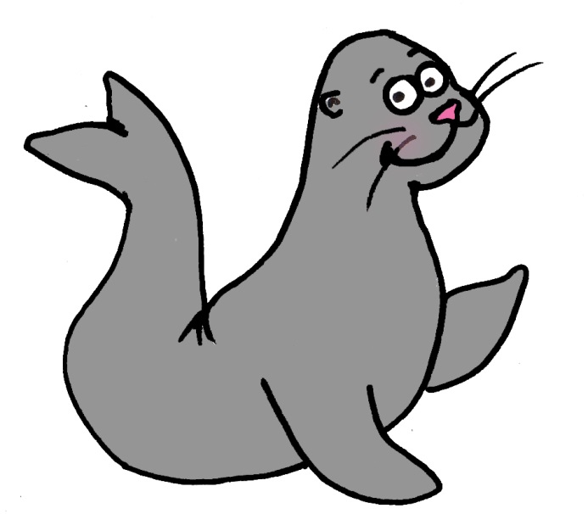
Notes:
SEAL

Slide 29
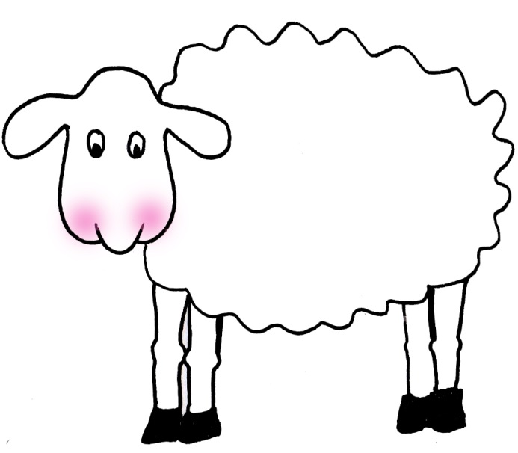
Notes:
SHEEP

Slide 30
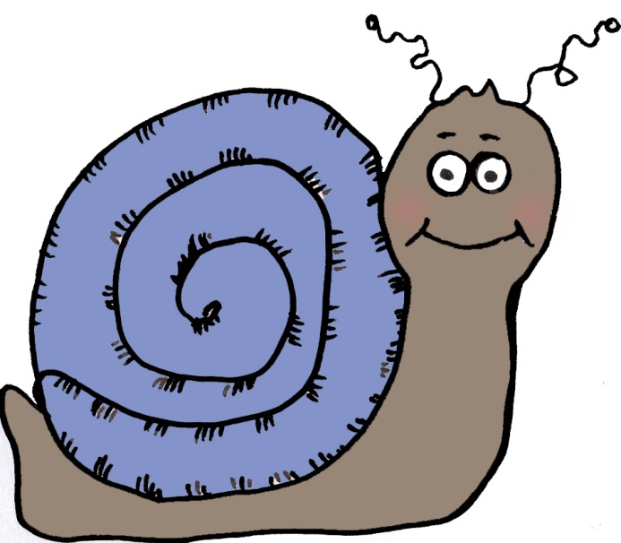
Notes:
SNAIL

Slide 31
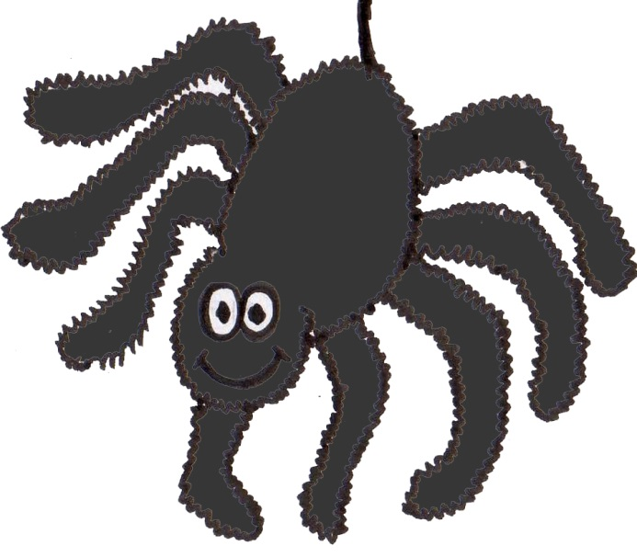
Notes:
SPIDER

Slide 32
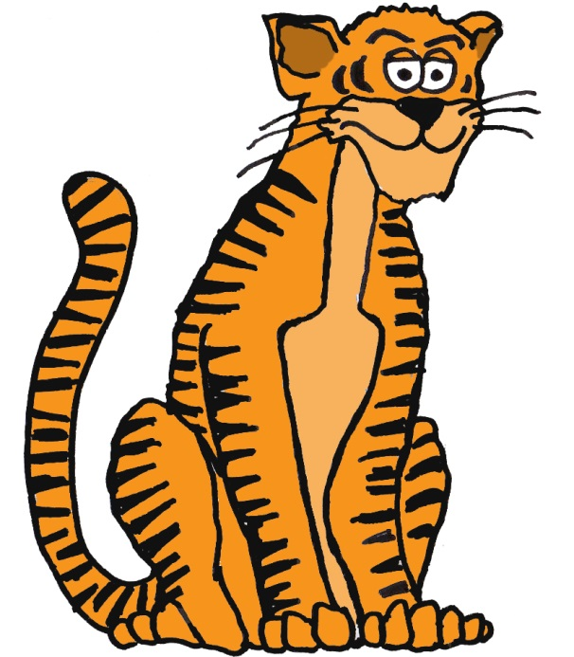
Notes:
TIGER

Slide 33
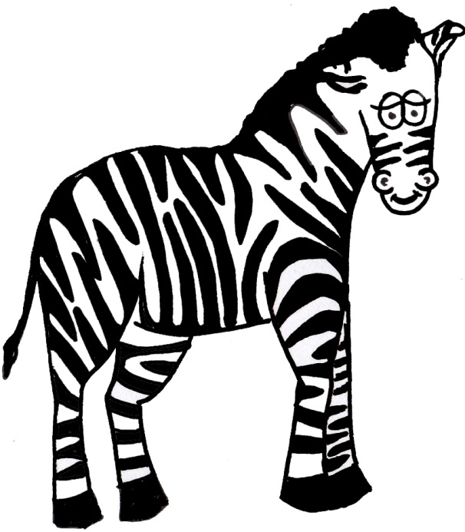
Notes:
ZEBRA

